Slide 1
Measure/Estimate vehicle yaw moment of inertia

Slide 2
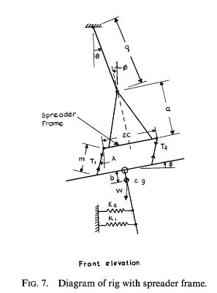
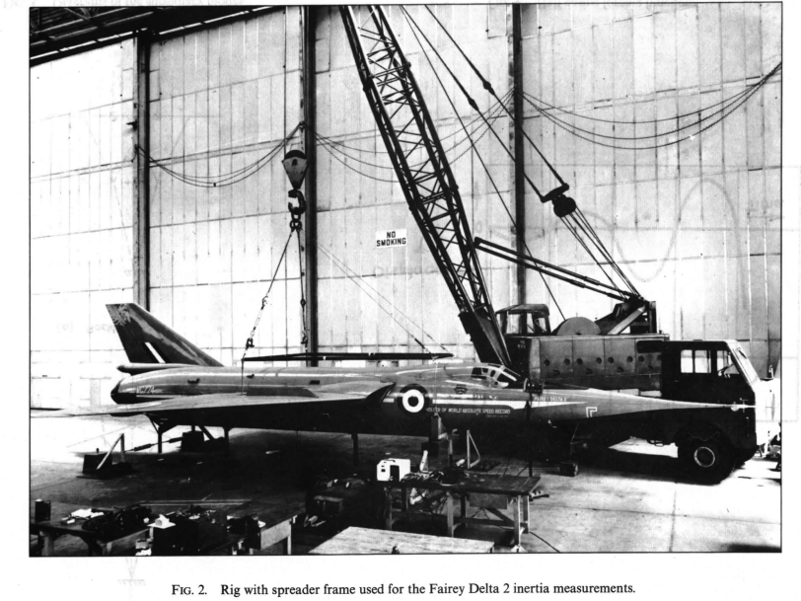
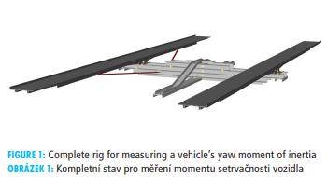
Measure vehicle yaw moment of inertia
Base on pendulum principle
Suspension method
Woodfield, A. A. (1969). Measurement of the yawing
moment and product of inertia of an aircraft by the
single point suspension method: theory and rig design.
Reports and memoranda (Aeronautical Research Council
(Great Britain)), No. 3607. https://reports.aerade.cranfield.ac.uk/handle/1826.2/2875
Torsion pendulum
HEJTMÁNEK, Petr, et al. Measuring the yaw moment of inertia of a vehicle. J. Middle Eur. Constr. Des. Cars, 2013, 11.1: 16-22.
http://archive.sciendo.com/MECDC/mecdc.2013.11.issue-1/mecdc-2013-0003/mecdc-2013-0003.pdf

Slide 3
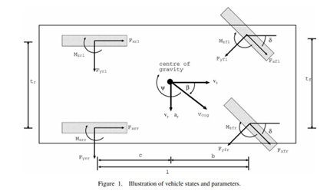
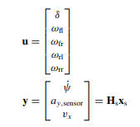
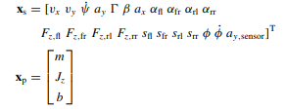
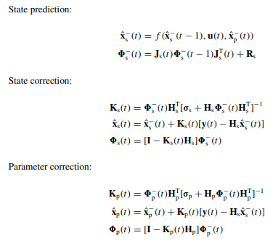
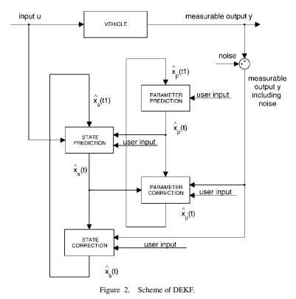
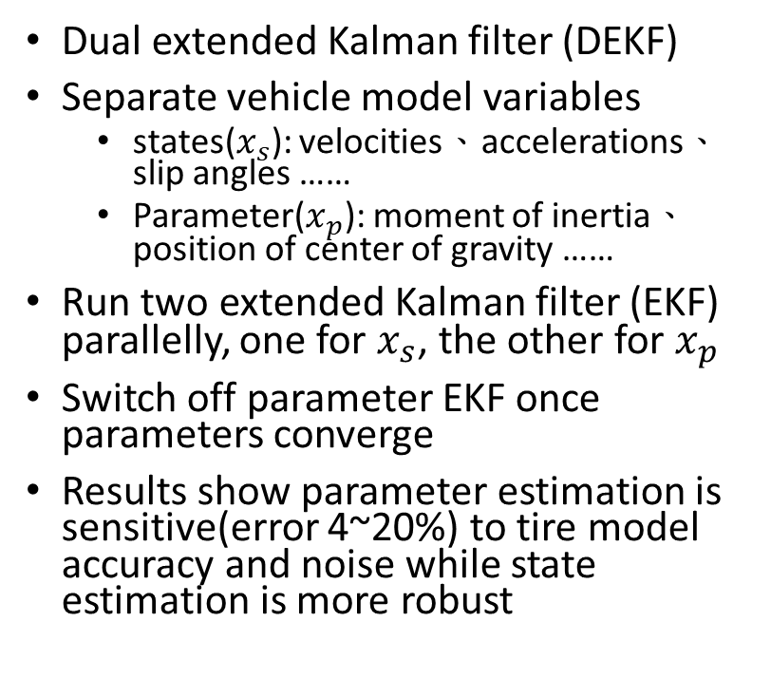
Estimate vehicle yaw moment of inertia—DEKF
Dual extended Kalman filter (DEKF)
Separate vehicle model variables
states($x_{s}$): velocities、accelerations、slip angles ……
Parameter($x_{p}$): moment of inertia、position of center of gravity ……
Run two extended Kalman filter (EKF) parallelly, one for $x_{s}$, the other for $x_{p}$
Switch off parameter EKF once parameters converge
Results show parameter estimation is sensitive(error 4~20%) to tire model accuracy and noise while state estimation is more robust
Wenzel, Thomas A., et al. "Dual extended Kalman filter for vehicle state and parameter estimation." Vehicle system dynamics 44.2 (2006): 153-171. https://www.tandfonline.com/doi/full/10.1080/00423110500385949

Slide 4
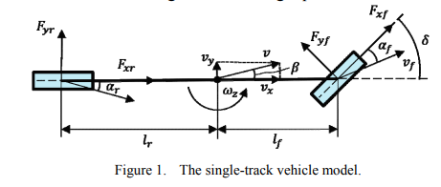
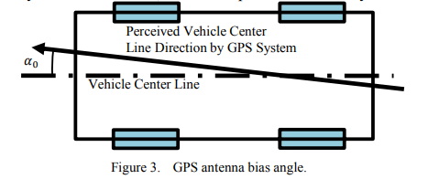
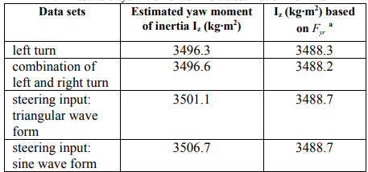
Estimate vehicle yaw moment of inertia—LSR
Least-Squares Regression (LSR)
The single-track vehicle model is used, relating lateral acceleration, yaw acceleration, and rear wheel lateral forces (Rear wheel lateral forces are estimated using a relaxation length tire model to capture transient dynamics)
Applying LSR in three parts:
Estimate the antenna bias angle
Estimate the tire relaxation length parameter
Finally estimate the yaw moment of inertia
Estimated value within 1-1.5% of CarSim value which is not ensure the precision
CarSim Data
Yu, Zitian, Xiaoyu Huang, and Junmin Wang. "A least-squares regression based method for vehicle yaw moment of inertia estimation." 2015 American Control Conference (ACC). IEEE, 2015.
https://ieeexplore.ieee.org/abstract/document/7172189/

Slide 5
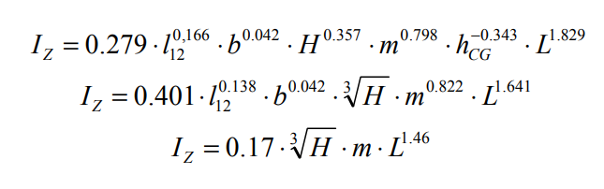
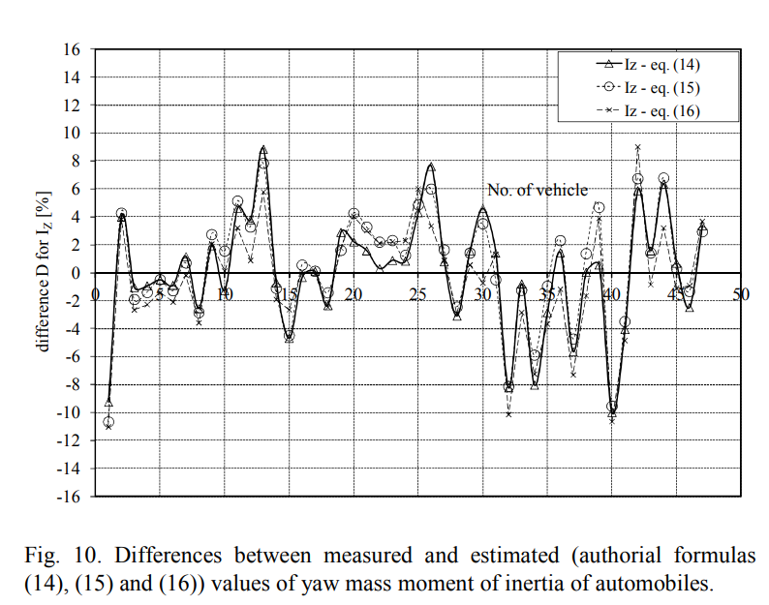
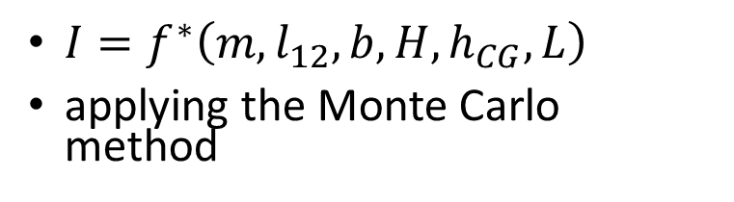
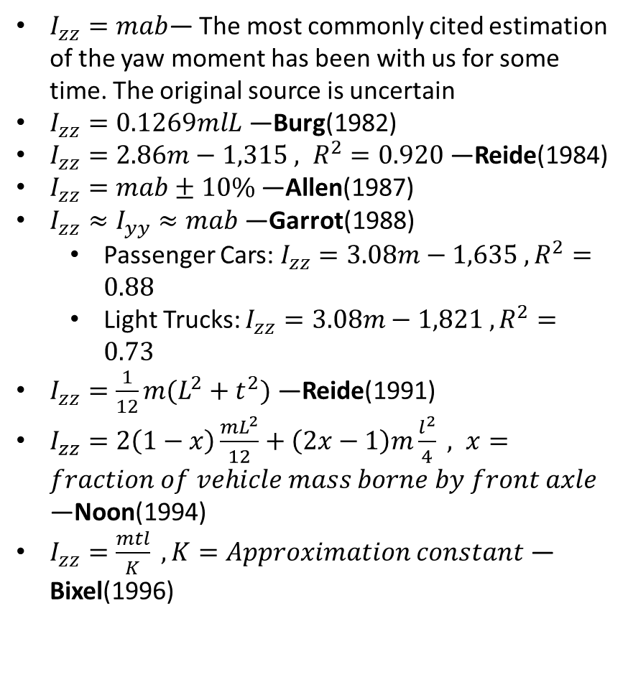
Estimate vehicle yaw moment of inertia—Empirical equation
$I_{zz}=mab$— The most commonly cited estimation of the yaw moment has been with us for some time. The original source is uncertain
$I_{zz}=0.1269mlL$ —Burg(1982)
$I_{zz}=2.86m−1,315 , R^{2}=0.920$—Reide(1984)
$I_{zz}=mab±10\%$—Allen(1987)
$I_{zz}≈I_{yy}≈mab$—Garrot(1988)
Passenger Cars: $I_{zz}=3.08m−1,635 , R^{2}=0.88$
Light Trucks: $I_{zz}=3.08m−1,821 , R^{2}=0.73$
$I_{zz}=\frac{1}{12}m(L^{2}+t^{2})$ —Reide(1991)
$I_{zz}=2\left(1−x\right)\frac{mL^{2}}{12}+\left(2x−1\right)m\frac{l^{2}}{4} , x=fraction of vehicle mass borne by front axle$ —Noon(1994)
$I_{zz}=\frac{mtl}{K} , K=Approximation constant$ —Bixel(1996)
$I=f^{∗}\left(m,l_{12},b,H,h_{CG},L\right)$
applying the Monte Carlo method
Fundowicz, Piotr, and Hubert Sar. "Estimation of mass moments of inertia of automobile." 2018 XI International Science-Technical Conference Automotive Safety. IEEE, 2018.
https://ieeexplore.ieee.org/abstract/document/8373326
Maclnnis, Duane D., et al. “A Comparison of Moment of Inertia Estimation Techniques for Vehicle Dynamics Simulation.” SAE Transactions, vol. 106, 1997, pp. 1557–75. JSTOR, http://www.jstor.org/stable/44731313. Accessed 25 Oct. 2023.

Slide 6
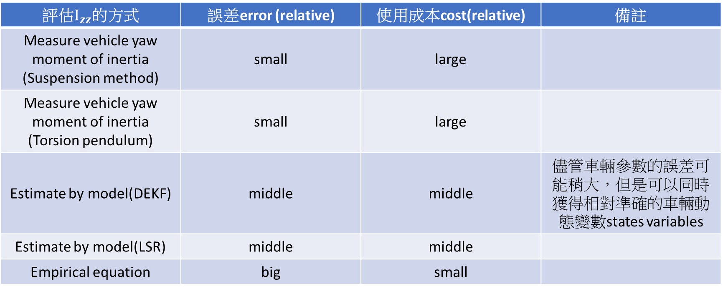
evaluation
評估$I_{zz}$的方式 | 誤差error (relative) | 使用成本cost(relative) | 備註
Measure vehicle yaw moment of inertia (Suspension method) | small | large
Measure vehicle yaw moment of inertia (Torsion pendulum) | small | large
Estimate by model(DEKF) | middle | middle | 儘管車輛參數的誤差可能稍大，但是可以同時獲得相對準確的車輛動態變數states variables
Estimate by model(LSR) | middle | middle
Empirical equation | big | small

